Slide 1
SFL Scientific Take home
Jeff Ott

Slide 2
What is a Data Lake? Explain its benefits, how it differs from a data warehouse, and how it might benefit a client.
Is data the new oil? Then a data lake is your national storage.
In simple terms, a data lake is a place to store all your raw data.
What is raw data? Raw data is any data that has yet to be processed for use. With all these methods of collecting data, the data lake provides a flexible low-cost service to store this data. If it differs from a data warehouse in purpose and the type of data. A data warehouse is better suited for tabular data, which is consistently accessed for predetermined business decisions. The client’s current needs are how I would recommend the storage for a client who is collecting a ton of data without the existing resources to process it into tabular form. The Data Lake is a solution to retain the data and its value for whatever analysis or business questions in a low-cost format.

Slide 3
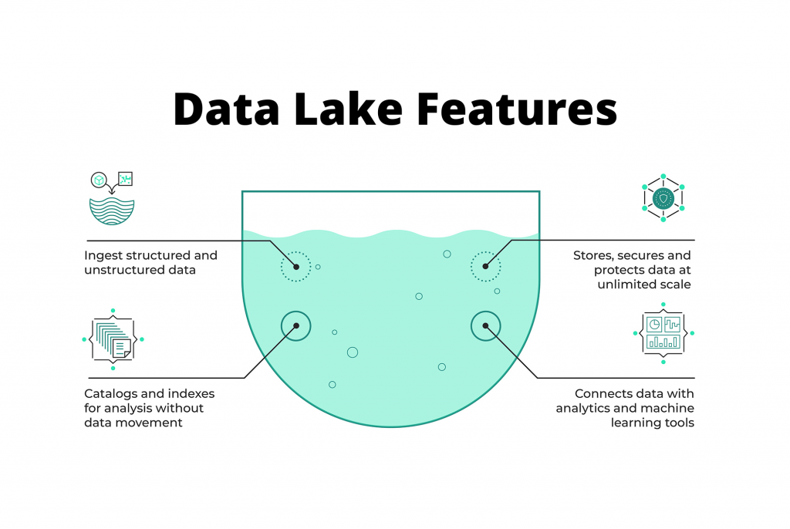
https://lakefs.io/data-lakes/

Slide 4
Explain serverless architecture. What are its pros and cons?
Serverless architecture is a bit of a misnomer, this pushes the burden of server management and scaling to a third-party provider. This allows your team more flexibility in computing resources and storage capabilities. It can also allows for a reduction in physical space, computing power, and costs (depending). Security is also handled
The cons are the extra expenses you may be incurring (depending). There is also the possibility that your cloud service provider will change terms with Vendor Lock in which could be a problem. Troubleshooting can also be difficult on these services.

Slide 5
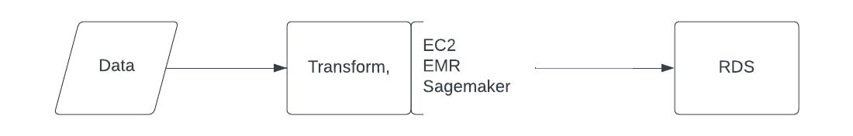
Please provide a diagram for an ETL pipeline (ex: Section 2) using serverless AWS services. Describe each component and its function within the pipeline.
Data can be local or stored in S3
EC2: This is where I will Extract and transform the data
RDS- Is where I will load the data

Slide 6
Describe modern MLOps and how organizations should be approaching management from a tool and system perspective.
Data Engineer
Data Scientist
MLOps
Mlops is model monitoring and deployment. It’s Mlops job to make sure your models are working efficiently and effectively. When the Data Scientist creates and proves the model the model needs to be applied to the business case. It’s the job of the ML Ops engineer to deploy and monitor the model for changes. This mean understanding the different avenues of deployment and understanding the tradeoffs. How do you scale your model for users. How you predict streamed in data. The Mlops engineer also needs to monitor the models use cases and adjust as your data adjusts.
Organizations should have a focused MLOPs group who works with both the Data Engineer and Data scientists. Costs and Risk should be at the forefront of each business mind when they think of MLOps. What is the benefit of having a scalable model but what is the risk of having a model which isn’t closely monitor. The System needs to work and the tools need to fit the job

